Slide 1
Do Now
Do you think the African American community still faces challenges when it comes to voting today?
Explain your answer.

Slide 2
March on Selma Packet Check in
After completing the packet:
Why do you think they chose a march as their tactic?
Why do you think they chose the route from Selma to Montgomery, Alabama as the place for this march?
Why was it important to have so many local people involved in the march?
How did the march change once Martin Luther King Jr. participated in the actual march? Why do you think this?
Make pile of packets at tables

Slide 3
Voting Rights
Modern Version of Issue

Slide 4
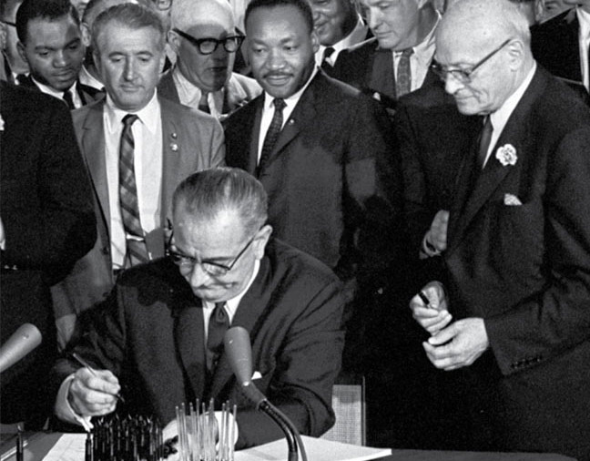
Voting Rights Act of 1965
Signed by LBJ
Goal: overcome legal barriers at state/local levels preventing African Americans from voting
Enforces 14th and 15th Amendment
No state can change voting laws with out federal approval

Slide 5
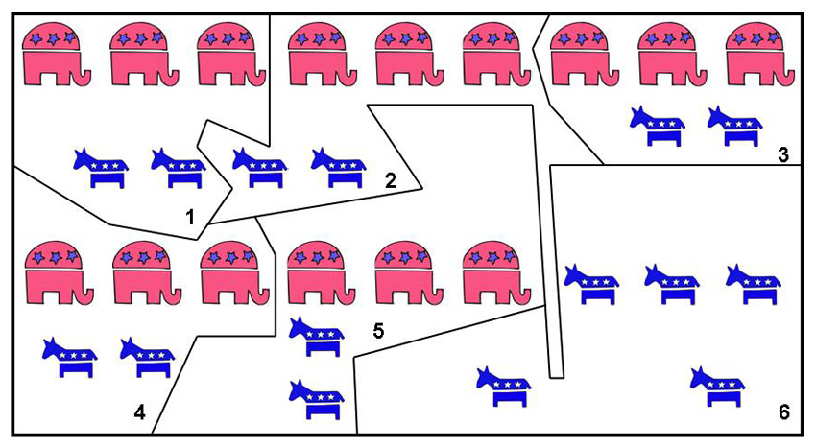
Gerrymandering
Party in power redraws voting districts to give one party an advantage over another party
Impacts election of representatives in House of Representatives
Southern Republicans gerrymander Democrats out of influence
1992-2016
87% of Black voters identify Democratic
7% of Black voters identify Republican
Black voters lose influence

Slide 6
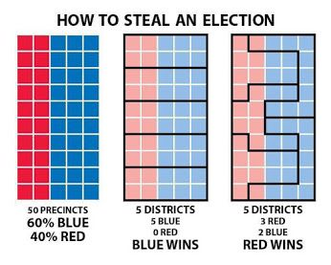
Black
Black
White
White
White
Black
Black
White

Slide 7
Gerrymandering Video
The Difference Between Racial and Partisan Gerrymandering

Slide 8
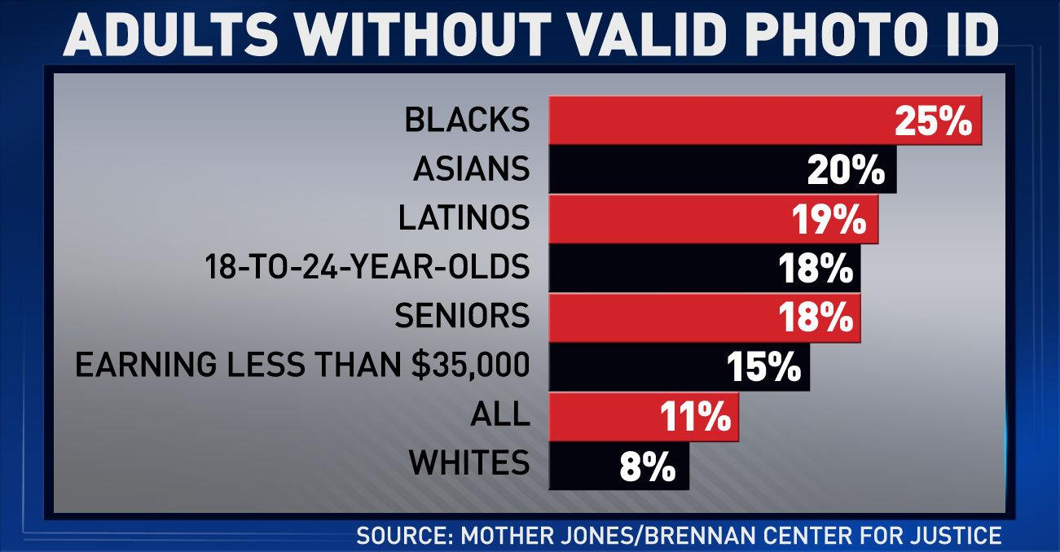
Voter ID Laws
June 2013 – Supreme Court struck down part of Voting Rights Act – states could now change voting laws w/out fed. approval
Require voters to show some sort of personal ID at polls to vote
2018: 33 states enact voter ID laws
Strictness is up to each state
18 states require photo identification
Controversial
Supporters claim it prevents voter fraud
There has been limited evidence
Opponents claim it targets ethnic, socio-economic groups

Slide 9
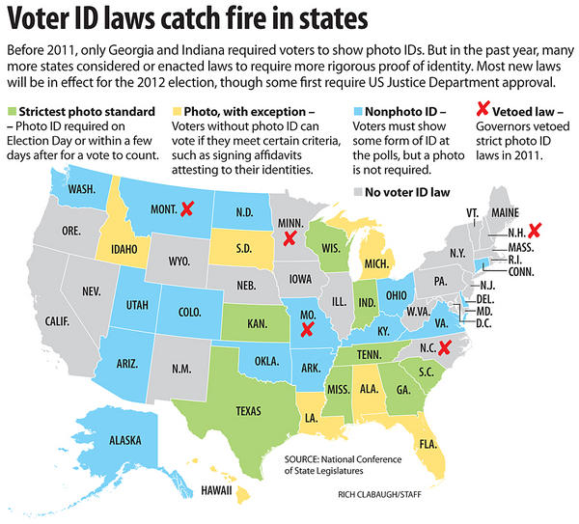

Slide 10
Current Voter ID Law Map
https://ballotpedia.org/Voter_identification_laws_by_state

Slide 11
How are voting rights still an issue to African Americans today? How has it changed?
What tactics would make the most sense today? Why?
Boycott
Contact representatives
Marches
Social media campaigns
Violence
Non-violent resistance
Court Appeals (legal)
Create organizations focused on this issue
Coalition building – creating alliances between different groups who are similarly affected
Who should be involved?

Slide 12
Article
https://www.nytimes.com/2017/05/15/us/politics/voter-id-laws-supreme-court-north-carolina.html
Summarize the article in your notes
Start with main idea, use power verbs
Questions to answer in your notes after the summary:
Do you think this issue in North Carolina is a civil rights issue? Explain your response.
What can you tell me about the reliability of this source?
Is this article too partisan or biased? (Partisan – supporting a particular political party)

