Slide 1
Do Now
Why is voting important?
How does not being able to vote affect you? Explain.

Slide 2
Voting Rights
Root of the Issue
Where did the issue of inequality come from and how does it affect African Americans?

Slide 3
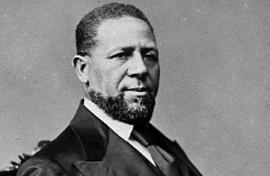
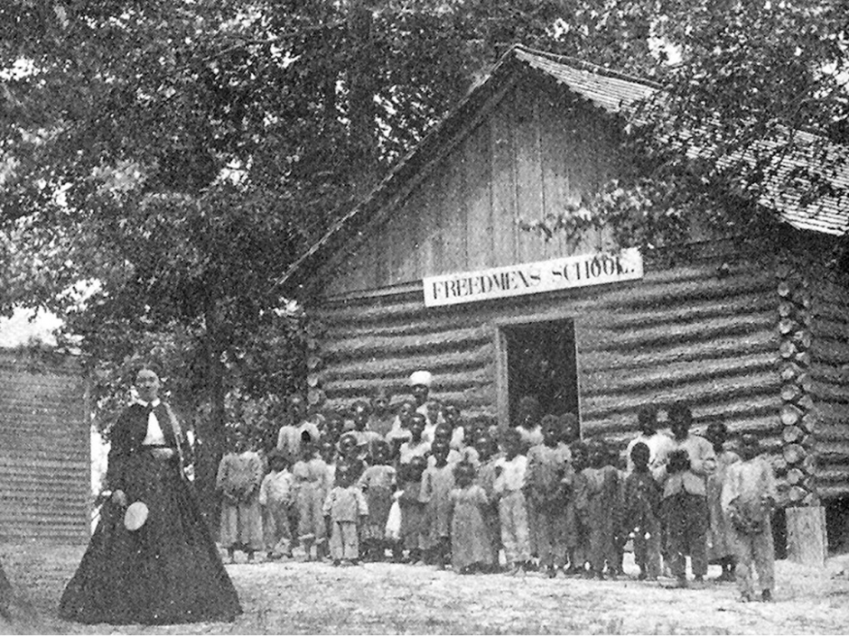
African Americans receive right to vote
15th amendment
All citizens can vote regardless of race
Black Representation
Surge in Black representatives
Hiram Revels replaced Jefferson Davis in Senate
Freedman’s Bureau
Provides money for Black education
Mobilizes registration

Slide 4
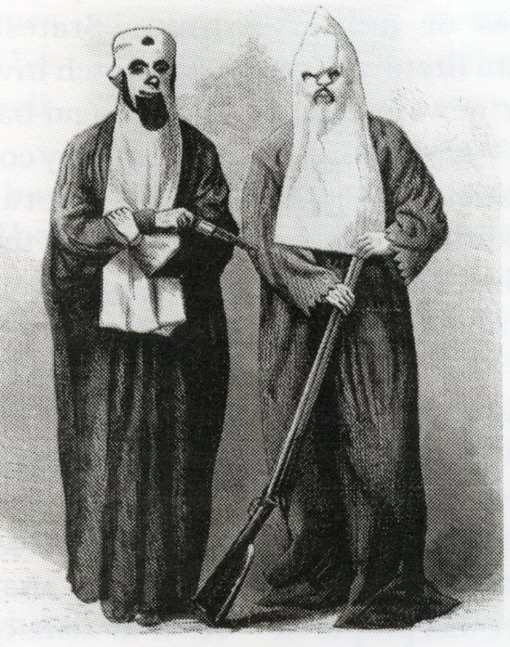
Reaction to African American voting rights
Poll tax/literacy clause
Obstacle for Blacks
Grandfather Clause
Exempted whites from poll taxes/literacy tests
White leagues created
KKK
Racist sentiment grows
Reconstruction ends
Freedman’s Bureau defunded
State constitutions altered
limit Black voting rights

Slide 5
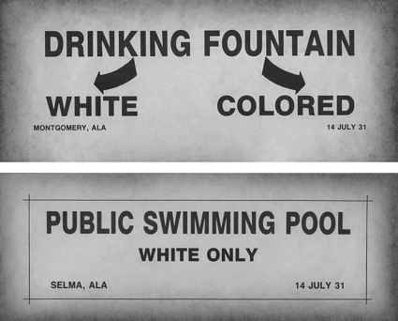
Effects of Voter Suppression
Increase in fear
Black voting decreases
Due to lower representation
Laws being passed that further suppress Black rights
Jim Crow laws
Gerrymandering
Voting districts redrawn to weaken Black vote in communities

Slide 6
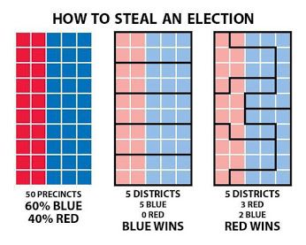
Black
Black
White
White
White
Black
Black
White

Slide 7
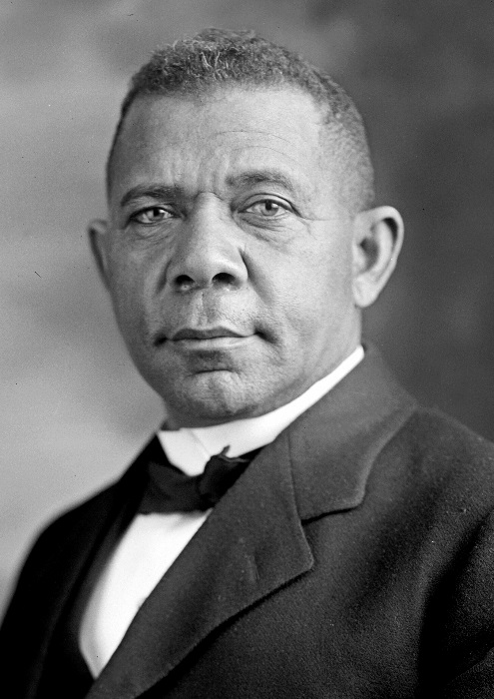
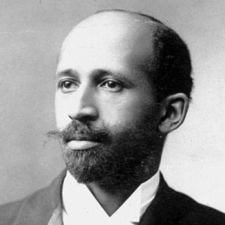
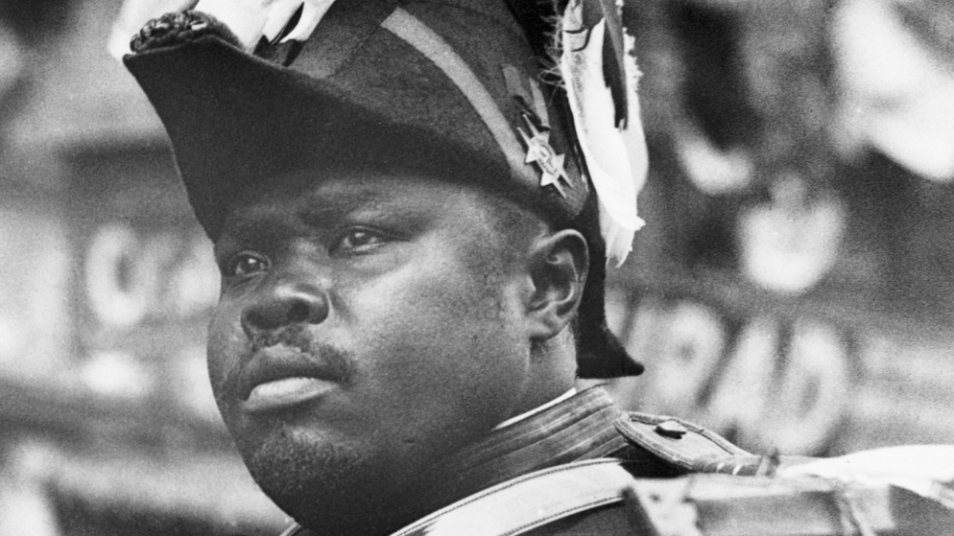
Early Attempts to Fight Back
Intellectual movement
Booker T. Washington
Focus more on economic equality
Tuskegee Institute
W.E.B. Du Bois
Strategic voting
Look for candidates advocating Black civil rights
NAACP
Marcus Garvey
Lead movement to celebrate race
UNIA
Black nationalism

Slide 8
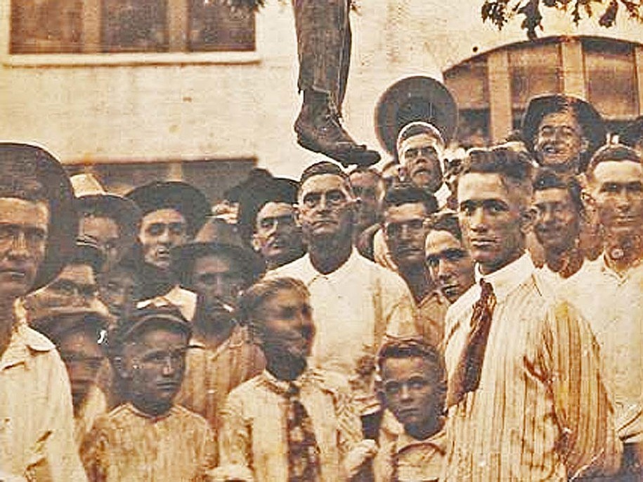
Hurdles/struggles for the “fight back”
Intellectual movement
Isolated to certain regions of country
Not embraced by white America
Not publicized enough to normalize
Institutionalized racism
Engrained in society, traditions, lifestyles
Difficult to change stubborn minds
Increase in violence in rural areas
Extremely aggressive
Intimidation grows

Slide 9
Differing Viewpoints
Not all activists had the same viewpoint on voting.
Read your group’s document
Note in your notes:
Who this person was?
What their viewpoint on voting or the significance of voting was?
What evidence/reason they give for their opinion.
Be ready to share out your findings to the whole class

