Slide 1
DO NOW

Slide 2
Red Scare
As the united States attempted to contain communism abroad, the search for communists at home led to an increase in gov’t created propaganda
This propaganda was created to:
Teach citizens how to deal with Possible attacks by communist nations – what to do if there is a nuclear attack
teach citizens How to determine who was a communist and who was not
Show citizens how their lives would be different if they lived under communism
All of it was aimed at creating fear and mistrust

Slide 3
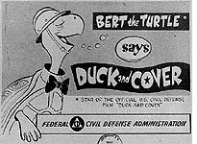
Red Scare Propaganda
This video was created to teach children what to do in case of a nuclear attack
While watching the video take notes of the questions on the handout, class discussion to follow
https://www.youtube.com/watch?v=IKqXu-5jw60

Slide 4
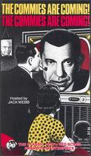
Red Nightmare!
This short film was created to show Americans how their lives would be different if they lived in a communist soviet union town
While watching the video take notes of the questions on the handout, class discussion to follow
https://www.youtube.com/watch?v=cgR4apcz_Ew

