Slide 1
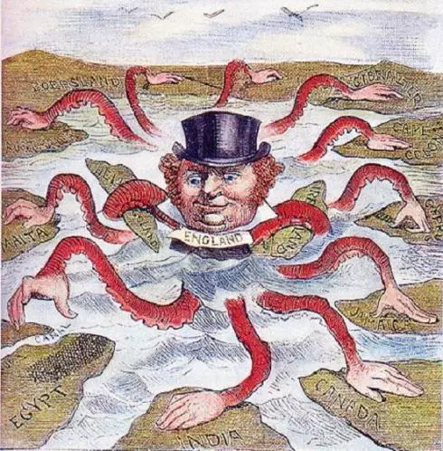
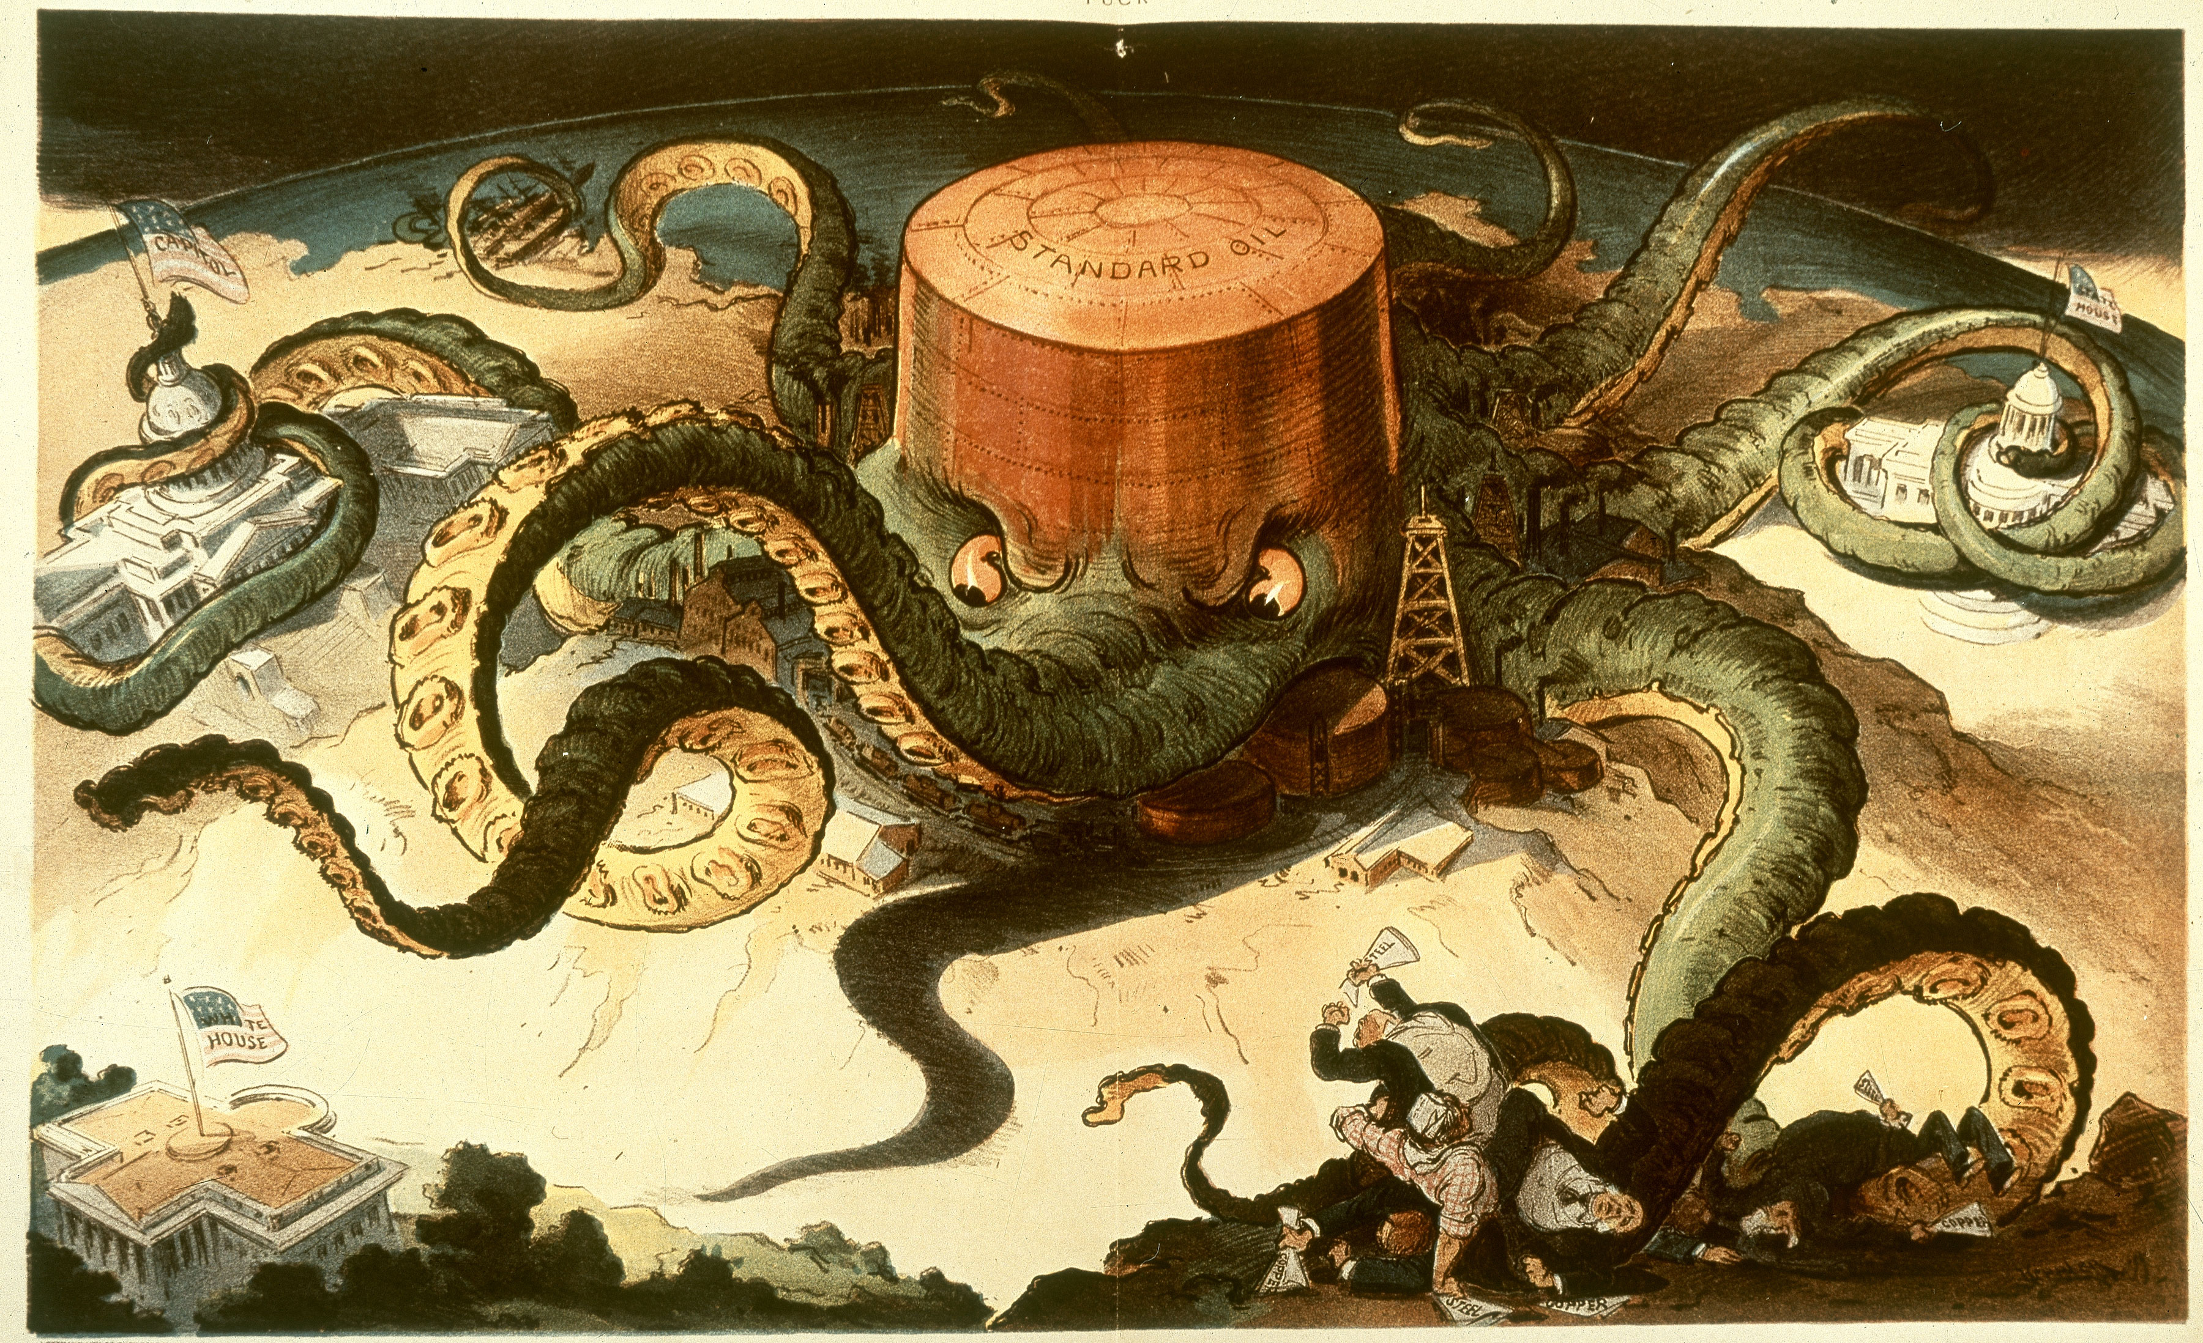
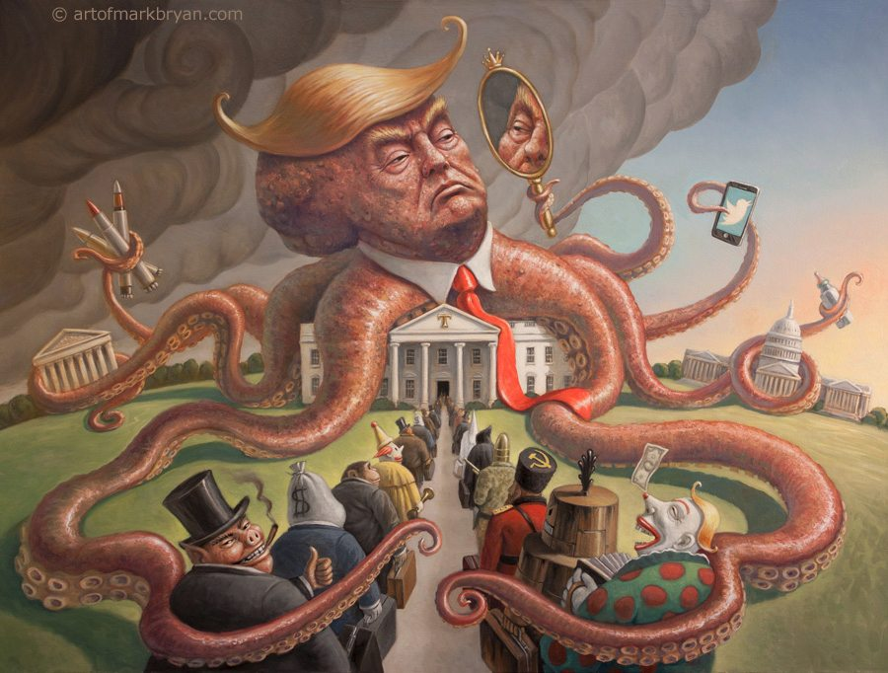
Do Now
What do you know about Political Cartoons? What are some things you need to look at when examining a political cartoon?

Slide 2
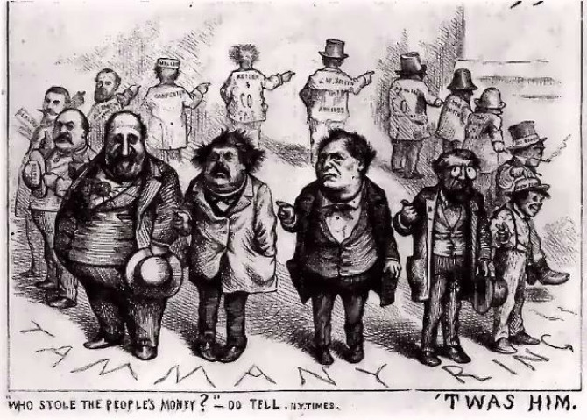
Political Cartoon Analysis – Practice – what do you see, who do you see, what do you think it represents

Slide 3
Political Cartoons
Political Machines

Slide 4
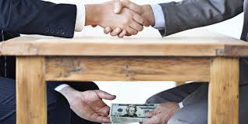
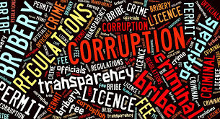
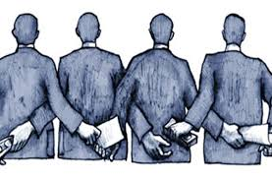
Growth of Corruption
Cities grew as a result of industrialization
Political corruption took control & became a problem
Misused immigrants
Bribery (graft)
Stole money
Voting fraud
Helped certain ethnic groups (Irish)
Political machines tried to control politics in a city
Multiple people involved

Slide 5
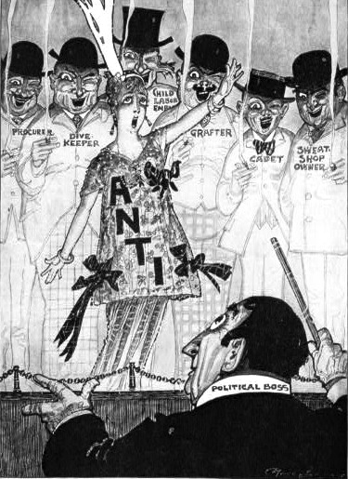
Political Bosses
Political Boss
Typically a mayor
Controlled things
Jobs, business licenses, housing
Influenced things
Courts, public projects, finances
Very corrupt
Provided favors in exchange for things
Votes, money, contracts

Slide 6
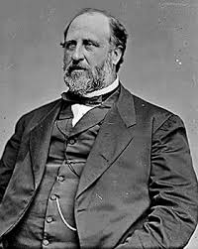
Boss Tweed
William M. Tweed
Aka Boss Tweed
Head of NYC political machine
Aka Tammany Hall
Scandal over rebuilding City Hall
Convicted of fraud and extortion

Slide 7
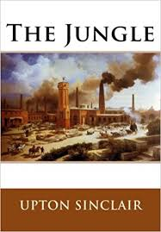
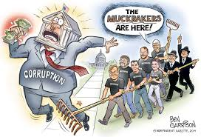
Muckrakers and Politics
Teachers, Authors, and Journalists
Challenged political and economic corruption through their writing during the Progressive Era.
Lincoln Steffens, Upton Sinclair, Ida Tarbell

Slide 8
Examining Political Cartoons and Documents - Rotation Activity
Today, with partners, you will be looking at some political cartoons, documents and a video regarding Political Machines
There are 2 political cartoons and 2 Documents you will look at on your own. We will do the video together as a class (station 4)
At your own pace, grab the documents located in front of the room and fill out the graphic organizer
We will finish tomorrow and go over your answers as a class.
Remember to be detailed in your answers and think beyond what is said in the documents and cartoons to answer some questions. For example, when it asks who was affected DO NOT just tell me “Americans.”

Slide 9
Exit Ticket
On a separate sheet of paper respond to the following
Describe the effects of political bosses/machines on cities and the people that lived there.

Slide 10
Word Bank
Political Boss/Machine- a leader in a political party who controls votes and controls who holds government position.
Corruption- Dishonest or fraudulence carried out by people in positions of power. Bribery is usually involved.
Tammany Hall- A political organization in New York City that was corrupt and abused their power. Also the building that headquartered the organization.
Graft- Illegal activity or corruption.
Muckrakers- Teachers, authors and journalists who challenged corruption and illegal political activity during the Industrial Revolution.
Industry- Economic activity concerned with producing and manufacturing goods and services.
Distinction- differences or contrasts between similar things or people
consequently- a result of something
looter-to rob of goods or valuables
authorities- people of power
prosperity- thriving condition, good fortune.

Slide 11
Video Link for Station
http://www.travelchannel.com/videos/the-story-of-boss-tweed-0217117

