Slide 1
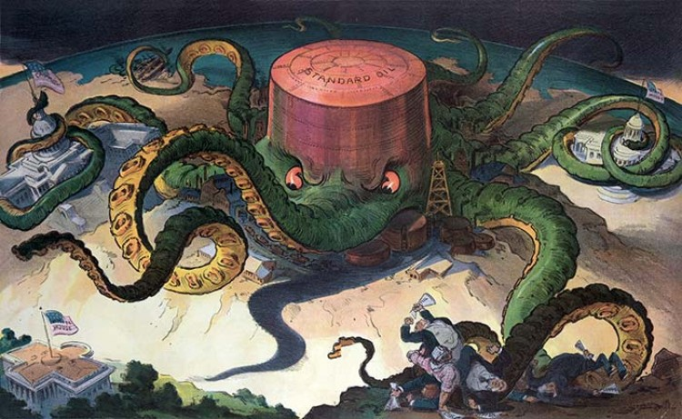
Do Now
What do you see in the photo? What do you think it represents?

Slide 2
Big Business in the United States

Slide 3
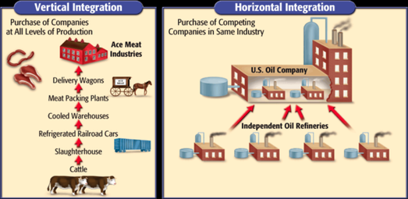
What is a monopoly
A company or corporation that takes complete control of the entire supply of goods/ services in a certain market
Trust – a few individuals monopolize an industry and split the profit
Vertical integration – own all levels of production
Horizontal integration – own all of competing companies in a single industry

Slide 4
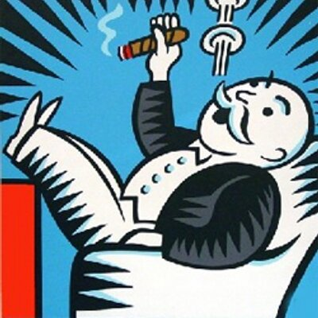
What caused monopolies?
Rich business men exploit weak economy after the Civil War/lack of gov’t regulation
Ex: no minimum wage or other labor laws
B/c US industrializes so fast
easier to let one business take over a market

Slide 5
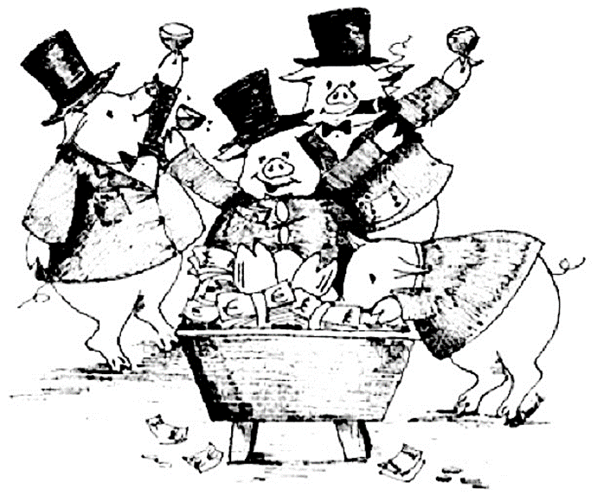
Who created monopolies?
“Robber Baron”- Big Businessmen during Industrial Revolution who used shady techniques to expand
Businessmen take advantage of the market/ create monopolies
These wealthy businessmen exploited industries including oil, railroads, steel and banks.
Produced low quality products and charged high prices
Used questionable practices in business to acquire their wealth

Slide 6
The Big 4
John D. Rockefeller- Standard Oil
Forced companies to merge with his company
Modeled the “trust” in business
Andrew Carnegie - Steel. Pittsburgh, the capital of the steel industry
Steel needed for railroads and development of growing cities
Nation Expanding
Cornelius Vanderbilt - Railroads
Transcontinental Railroad
Faster travel, ability to ship goods to all over the United States
J.P Morgan - Banks
They still exist today
Gave loans and asset assessor for railroads.
Insider Trading

Slide 7
Problems with Monopolies
Very few gov't regulations =
Monopolies grow
Mistreatment of workers
Politicians bend to will of monopolies
Lack of competition in certain markets
Higher prices for low quality product

Slide 8
How Big Business Affects Americans
Legal Rights of Americans limited
Blocks the average American to compete in the market and open their own businesses
low wages for work
No gov’t protection for workers
Low supply of product → prices go up on consumer goods
Many Americans affected:
Workers, including women and children
Immigrants
Small Businesses
Farmers
Politicians.
Business Leaders/Factory Owners.

Slide 9
Fill out your graphic organizer for Big Business!
Use your notes from today

Slide 10
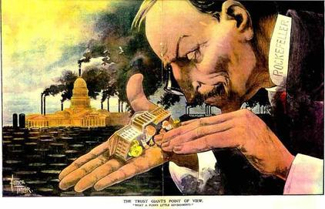
The Trust Giants Point of View
“What a funny little government”
Do Now
How is the artist portraying Rockefeller? The gov’t? Explain

Slide 11
Step 1:
You will be writing a letter as either:
A worker, Robber Barron, or a politician in the 1870’s
You are writing to your local newspaper to have your opinion heard
Should be at least one page long
Your letter to the newspaper should contain:
Your daily life experiences in America
How does big business affect your life, liberty, pursuit of happiness
How you feel about monopolies
How monopolies are either helping/hurting America
Your arguments as to why monopolies/trusts should be legal or not
Prices
Competition
“Survival of the fittest “
Explanation of why your opinion matters
Step 2:
Switch papers with your partner:
Read their letter to the newspaper
Consider their perspective
Write a response to them from your assigned perspective, include:
Questions you have for them
Do you agree or disagree with them? On what issues?

Slide 12
Switch papers with your partner:
Read their letter to the newspaper
Consider their perspective
Write a response to them from your assigned perspective, include:
Questions you have for them
Do you agree or disagree with them? On what issues?

