Slide 1
DO NOW
What aspects of life and the functioning of our country should the gov’t be in charge of? Explain.
Bonus Question – Why do we celebrate Labor Day?
Turn in DOI Activity into drawer
If you did the extra credit, please have it out on your desk for me to collect!!

Slide 2
Articles of Confederation

Slide 3
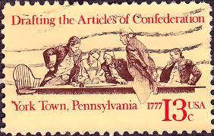
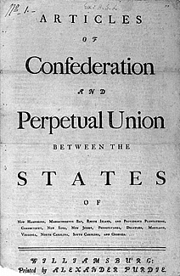
1st American Government
Created at end of Revolution
representatives from 13 colonies
Est. Articles of Confederation
1st gov’t structure & law making body
Major features
Gave country name
Representative democracy
Equal rep for all states
Limited power given to the gov’t
No president, only Congress

Slide 4
Discussion
What problems do you think could arise from the Articles of Confederation?
Major features
Gave country name
Representative democracy
Equal rep for all states
Limited power given to the gov’t
No president, only Congress

Slide 5
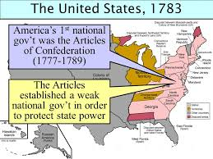
Strengths of Articles
Created unity
League of friendship during Revolution
Supported free movement & commerce between states
More independence for states
gave authority to Congress to take care of international affairs
Everything is fair

Slide 6
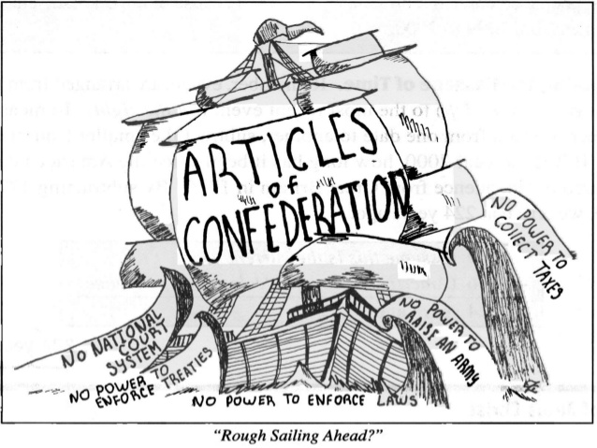
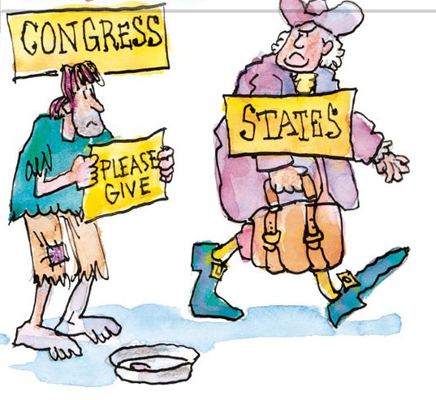
Weaknesses of Articles
Congress can’t tax
Each State = 1 vote (population doesn’t matter)
All states must agree for change
No Executive Branch to enforce laws
No Federal Courts
No national unity
No mention of slavery & what to do about it

Slide 7
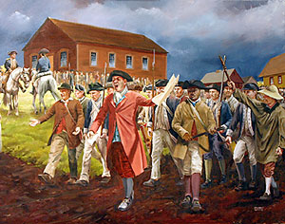
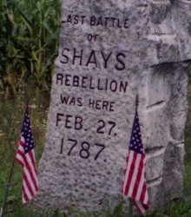
Shay’s Rebellion
Revolutionary War ended
States have war debt
States are taxing high to pay off debt
Soldiers got paid in bonds
IOUs from the gov’t
Rich control economy
Demand payments in hard currency (silver/gold)
Poor farmers rebel
losing land
Can’t barter anymore
State militia has to bring down rebellion
Shows that the federal gov’t doesn’t have power to help

Slide 8
What do you know about the Constitution?
What is the Constitution?
Why is it important?
What’s the difference between the Declaration of Independence and the Constitution?
Who wrote the Constitution?
What rights does it give us?
What rights doesn’t it give us?

Slide 9
Constitutional Role Play- Day 1
Step 1: In your group read about your role at the Constitutional Convention
Step 2: ALL GROUP MEMBERS - Answer Qs at the bottom of your group’s worksheet (write your answers on the bottom or on a separate sheet of paper)

Slide 10
Constitutional Role Play – Day 2
Step 1: Read Burning Issues & discuss and determine your position/resolutions to the issues→ Write resolutions on the paper
Step 2: Determine who will be traveling from your group to negotiate compromises with other groups and who will stay behind to receive members from other groups
Step 3: Return to your group and review your positions/resolutions after compromises and rewrite your final resolutions on a separate sheet of paper

Slide 11
Constitutional Role Play- Day 3
Step 1: Groups will be allowed to offer and explain a resolution for one topic, and then it must be seconded
Step 2: Then it will be written on the board and one representative will answer questions about it
Step 3: Once all resolutions have been written and discussed, then they will be voted on
Step 4: Wrap-up discussion and what really happened

Slide 12
Which social groups made alliances with each other? Do you think that similar alliances were made in real life?
Why might it have been easier for the wealthy social groups to unite and harder
for the poorer social groups to unite?
Which social groups had absolutely conflicting interests—where no compromise was possible?
In real life, how do you think the Constitution dealt with the issues we confronted in our class Convention?
Which social groups wanted a strong national government? Which wanted the states to have more power? Why?
Which social groups wanted the greatest amount of democracy—power to the people? Which wanted the least? Why?

Slide 13
Questions | Actual Constitutional Convention
1a. Should slavery be legal in the any of the US? (Article I, Section 9, Clause 1) | Slavery is never directly mentioned in the Constitution, but it is implied that it is still legal
1b. Should the slave trade continue to be allowed? (Article I, Section 9, Clause 1) | Congress can prohibit the trade of slaves after 1808, but may currently tax the importation of slaves
1c. Should northerners be forced to turn over runaway (fugitive) slaves to their owners? (Article IV, Section 2, Clause 3) | Anyone who has fled slavery or servitude must be returned to the person who owns them
2. Will it be legal for state legislatures to pass laws allowing debts to be paid “in kind”? (Article I, Section 10, Clause 1) | No – states may only use gold or silver as a form of payment
3. Should bonds issued during the Revolutionary War be paid back? (Article VI, Clause 1) | Yes
4. Who should be allowed to vote in general elections? | Constitution doesn’t mention which meant it was left up to states to decide – white land owning males

