Slide 1
DO NOW
1. What would influence you to leave your hometown?
1. a. Would you leave?
2. Why do you think people would leave a world they know for something unknown?

Slide 2
American Colonies

Slide 3
Colonization
Europeans came to America looking for resources, land, and power
Why did people come?
-Religious freedom
-Political freedom
-Business/trade/farming
3 distinct regions formed

Slide 4
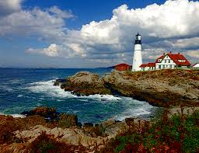
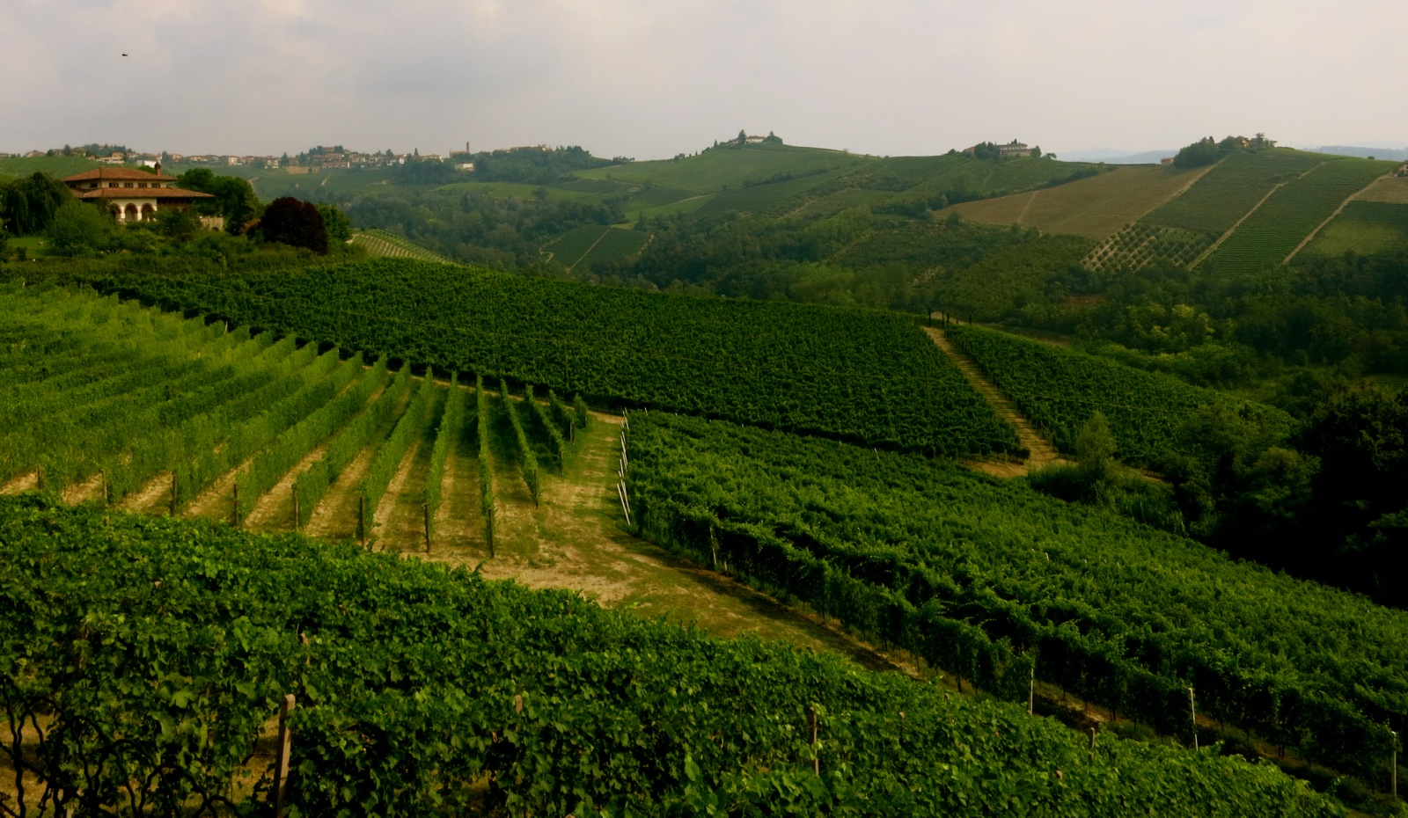
Regionalism
Each region progressed differently
Certain regions were better suited for certain climates, populations, and industries
Different crops, religion, and gov’t built up in different regions

Slide 5
The 3 Regions
New England
Massachusetts (MA)
New Hampshire (NH)
Rhode Island (RI)
Connecticut (CT)
Middle
New York (NY)
New Jersey (NJ)
Delaware (DE)
Pennsylvania (PA)
Southern
Maryland (MD)
Virginia (VA)
North Carolina (NC)
South Carolina (SC)
Georgia (GA)

Slide 6
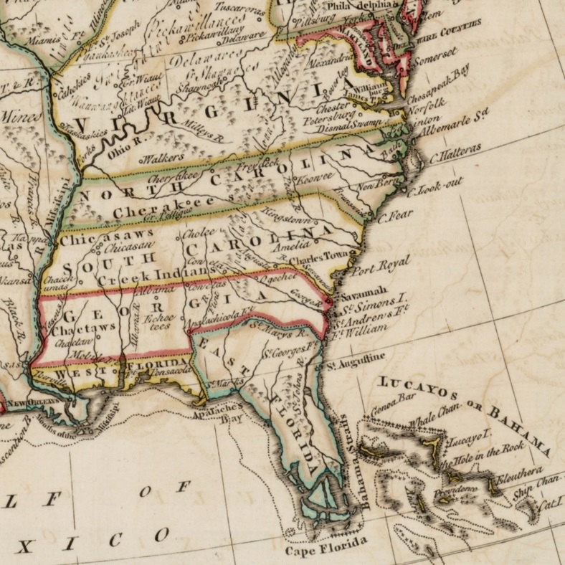
The Southern Colonies
Came from:
Western Europe - England, Scotland, Germany, Switzerland, Netherlands
First settled in 1606 – Jamestown
Culture/Customs:
Mostly men
Mostly some form of Christianity – esp. Anglican, Protestant and Catholic
Mostly explorers and entrepeneurs
Indentured servants – worked for an employer in return for paid passage to the New World until debt was paid

Slide 7
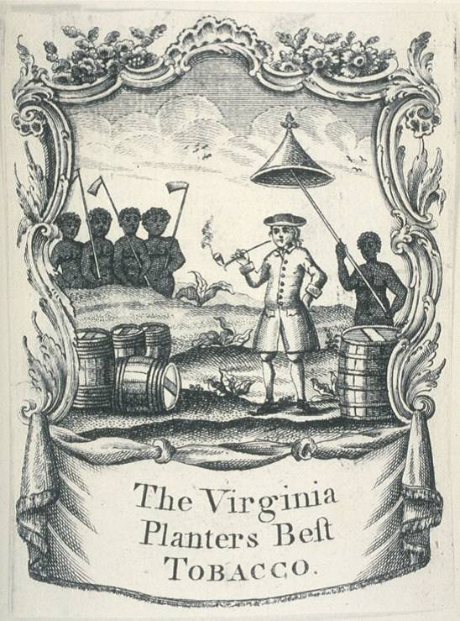
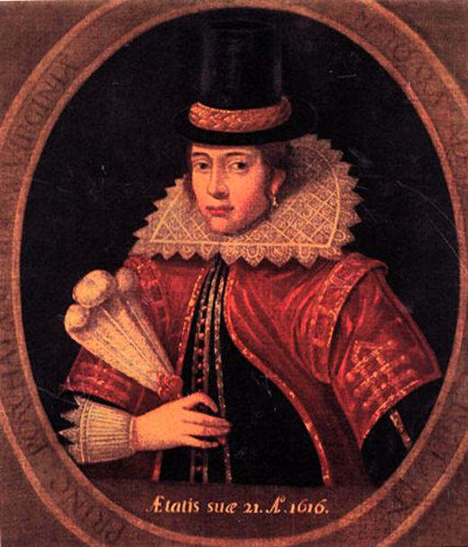
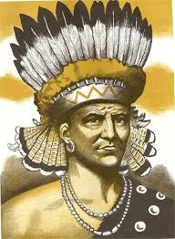
Southern Colonies
Why :
New economic opportunities, get out of debt, establish charters for certain British elite
Where did they settle:
Southern and Plantation Colonies (Virginia, Carolinas, Georgia, Maryland)
Effects on America:
established the slave trade
new farming techniques (plantations)
brought new invasive crops and diseases
established idea of land ownership
religious tolerance
global trading routes
Native Reaction:
Constant warfare
Died due to new diseases (smallpox, influenza)

Slide 8
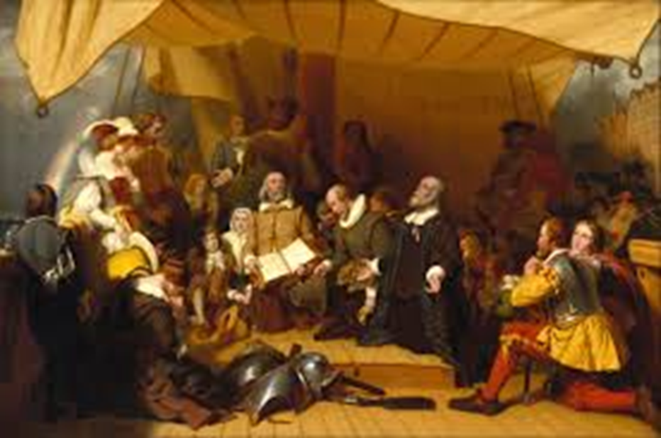
The New England Colonies
Came from:
England
Settled in 1620 – Plymouth Rock
Customs
Puritanism
Predestination belief that only select few are destined for heaven
Intolerant of anyone different
Focused on work
Segregation between the sexes
Life/society revolved around church
Controlled economy and behavior
Towns were established by family units
Non-Puritans
Jews, other Christians

Slide 9
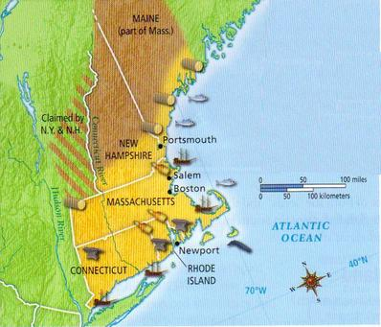
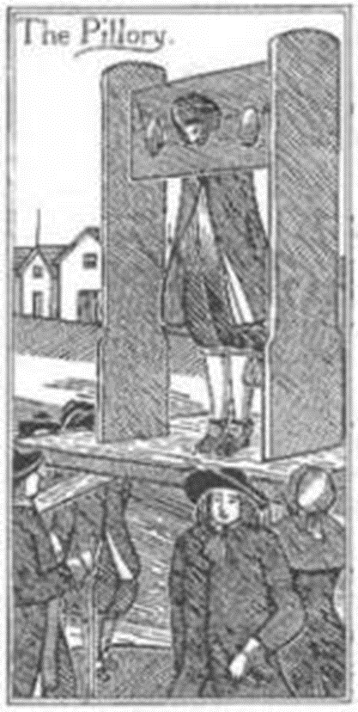
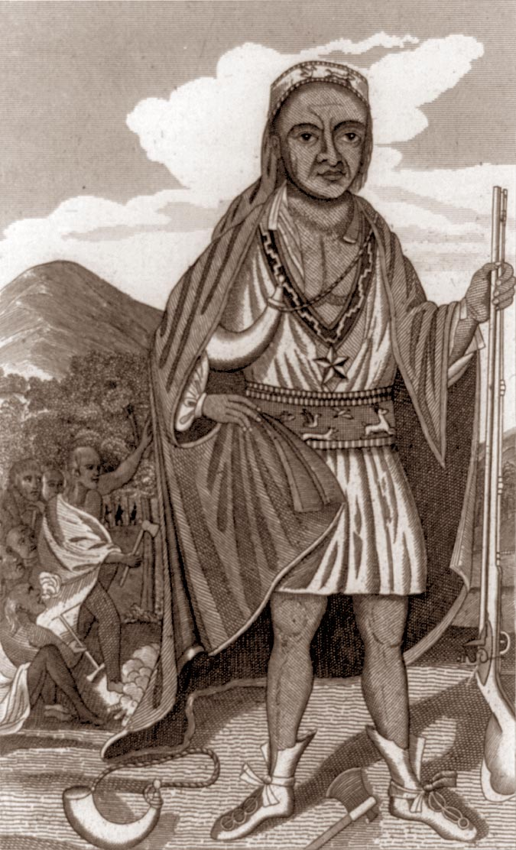
The New England Colonies
Why :
Wanted religious freedom
Where did they settle:
Massachusetts, Connecticut , Rhode Island
How did they affect America:
Established feelings of intolerance and mistrust – Salem Witch Trials, murder of non-Puritans
Puritan (Protestant) work ethic – frugal, hard-working
First towns
Focus on education – Need to be able to read the Bible
Mostly family farms with some small businesses
Non-Puritans – exercised religious liberty
Native Reaction:
Puritans = intolerant →constant war
Example: King Phillip’s War

Slide 10
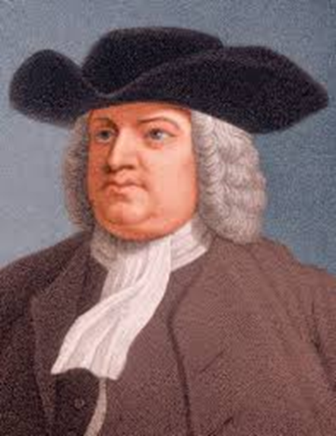
The Middle Colonies
Came from:
Northern Europe
1620s – New Netherlands
Customs
Quakers - members of the Religious Society of Friends
More religiously tolerant
Greater gender equality
community focused
Pacifism
Smaller family farms
Merchants
Non-Quakers
New Amsterdam – Dutch colony
Focused on trade
Cosmopolitan
William Penn

Slide 11
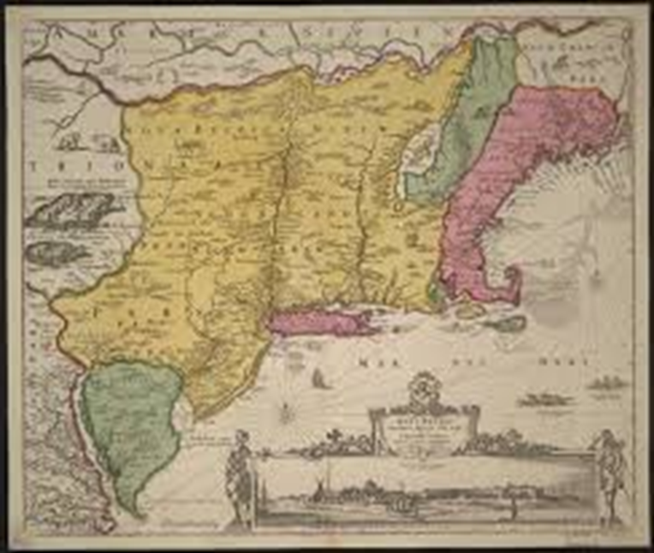
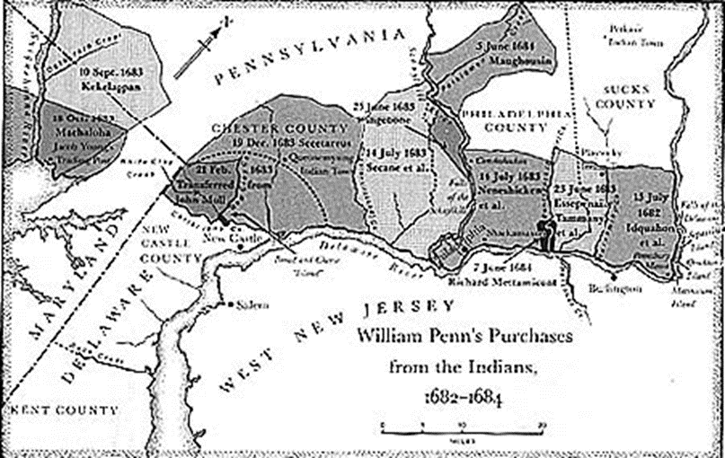
The Middle Colonies
Why :
Missionary work
Promised land and religious freedom
Establish chartered territories for British monarchy – Duke of York; King Charles
Where did they settle:
Pennsylvania, Delaware, New York
How did they affect America:
Divided land more evenly among families and individuals
Promoted better relations with religious groups and natives
Established the first merchant class
Native Reaction:
Many treaties signed between natives and settlers, while others conned natives out of their land

Slide 12
Exit Ticket
Based on what you saw in the slides, which region would you move to?
Things to think about:
Economic struggle
Community structure
Native relations

Slide 13
Activity - Colonial Advertisement
You will be working INDIVIDUALLY to create a Colonial Advertisement brochure (think about a travel brochure)
Requirements – Pick ONE of the colonial regions we talked about yesterday
Advertisement Brochure should include…
Name of Region
5 Facts about the region in your OWN words (be creative) NO BULLET POINTS
Political Structure, Economics, Reasons for Migration, Relationships with Indigenous Peoples, Daily life
Slogan
For example, Reno’s slogan is “The Biggest Little City in the World”
Pictures (drawn)
COLORFUL (MS. REYES LIKES COLORS)
BONUS POINTS→ Testimonial (ACTUAL testimonials from the time period – think of a yelp review)

